Slide 1
Using the formula for the area of a circle
Perimeter, area and volume

Slide 2
how to use Oak lessons

Slide 3
I can use the formula for the area of a circle to calculate either the area or a missing measurement.

Slide 4
The area is the size of the surface and states the number of unit squares needed to completely cover that surface.
The radius is any line segment that joins the centre of a circle to its edge.
The diameter of a circle is any line segment that starts and ends on the edge of the circle and passes through the centre.

Slide 5

Using the formula for the area of a circle
Finding areas of circles by using the formula
Finding the radius or diameter when the area is known

Slide 6
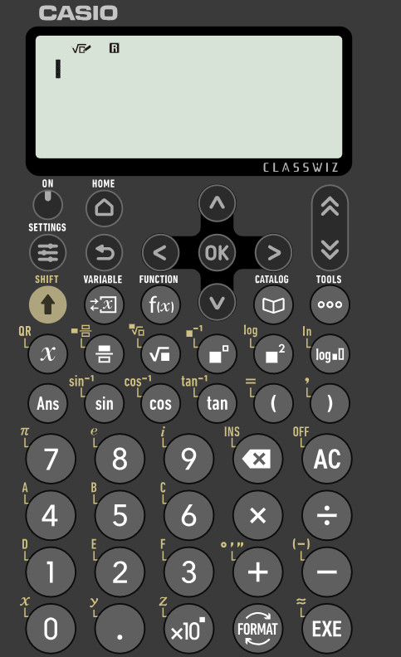
Finding areas of circles by using the formula
The formula A = πr² can be used to calculate the area of a circle.
Calculations can be performed accurately with π on a scientific calculator by pressing shift and then the π button.
shift
Answers can be written in terms of π or can be converted to a decimal by pressing the format button and then selecting decimal.
π
format

Slide 7
Finding areas of circles by using the formula
The area of a circle can be calculated when the radius is known by using the formula A = πr², where r is the radius.
area = π × 10²
10 mm
= 100π mm²
= 314.159265… mm²
≈ 314 mm²
Areas can be written accurately in terms of π.
Areas can also be written in decimal form.
Decimal solutions should be rounded to a suitable degree of accuracy.

Slide 8
Finding areas of circles by using the formula
When the diameter of a circle is given, the radius can be obtained by halving the diameter.
The formula A = πr² can then be used to calculate the area.
radius = 20 ÷ 2
area = π × 10²
= 10 mm
= 100π mm²
20 mm
= 314.159265… mm²
10 mm
≈ 314 mm²

Slide 9
Finding areas of circles by using the formula
You may need to determine whether a length given is equal to the radius or diameter before you calculate the area.
Example 1:
Example 2:
8 cm
8 cm
radius = 8 cm
diameter = 8 cm
8 cm
radius = 4 cm
area = π × 8²
8 cm
= 64π cm²
area = π × 4²
= 16π cm²

Slide 10

Finding areas of circles by using the formula
Which calculation would find the area of the circle?
π × 6²
12 m
π × 12²
π × 24²

Slide 11
Finding areas of circles by using the formula
Which calculation would find the area of a circle that has a diameter of 8 cm?
π × 4²
π × 8²
π × 16²

Slide 12

Finding areas of circles by using the formula
Jacob has calculated the area of the circle and given his answer in terms of π.
Write Jacob’s answer as a decimal, rounded to 3 significant figures.
area = π × 4²
4 cm
= 16π cm²
≈ 50.3 cm²

Slide 13
Finding areas of circles by using the formula
In some cases, you may need to first determine the length of the radius or diameter before calculating the area.
diameter = 8 units
radius = 4 units
4 units
8 units
area = π × 4²
= 16π units²
≈ 50.3 units²

Slide 14
Finding areas of circles by using the formula
In some cases, you may need to first determine the length of the radius or diameter before calculating the area.
y
radius = 4 units
4 units
area = π × 4²
(5, 5)
(9, 5)
= 16π units²
≈ 50.3 units²
x

Slide 15
Finding areas of circles by using the formula
Which calculation would find the area of the circle?
π × 2²
π × 4²
π × 8²

Slide 16
Finding areas of circles by using the formula
Which calculation would find the area of the circle?
y
π × 1²
π × 5²
(6, 6)
π × 6²
π × 10²
(6, 1)
x

Slide 17
Finding areas of circles by using the formula
1) Find the area of each circle, giving your answers as decimals rounded to 3 significant figures. Diagrams are not drawn to scale.
a)
circle with radius 6 m
b)
circle with diameter 6 m
c)
d)
22 mm
4 cm
e)
f)
g)
h)
28 mm
6.2 cm
14 mm
8.4 cm
9 cm

Slide 18

Finding areas of circles by using the formula
2) Find the area of each circle, giving your answers in terms of π.
a)
The distance from the centre of a circle to the circumference is 12 cm.
b)
The greatest distance across a circle is 12 cm.
area = cm²
area = cm²
c)
d)
y
e)
(4, 4)
(14, 4)
x
area = units²
area = units²
area = units²

Slide 19
Finding areas of circles by using the formula
1) Find the area of each circle, giving your answers as decimals rounded to 3 significant figures. Diagrams are not drawn to scale.
a)
circle with radius 6 m
b)
circle with diameter 6 m
c)
d)
22 mm
4 cm
area = 113 m²
area = 28.3 m²
area = 50.3 cm²
area = 380 mm²
e)
f)
g)
h)
28 mm
6.2 cm
14 mm
8.4 cm
9 cm
area = 121 cm²
area = 616 mm²
area = 55.4 cm²
area = 63.6 cm²

Slide 20
Finding areas of circles by using the formula
2) Find the area of each circle, giving your answers in terms of π.
a)
The distance from the centre of a circle to the circumference is 12 cm.
b)
The greatest distance across a circle is 12 cm.
144π
36π
area = cm²
area = cm²
c)
d)
y
e)
(4, 4)
(14, 4)
x
9π
25π
4π
area = units²
area = units²
area = units²

Slide 21
Using the formula for the area of a circle
Finding areas of circles by using the formula
Finding the radius or diameter when the area is known

Slide 22
Finding the radius or diameter when the area is known
In cases where the area is known, the formula A = πr² can be used to calculate the radius.
This can be done by substituting the known values into the formula to form an equation and then rearranging the equation.
This will usually involve dividing the area by π and then finding the square root.
To maintain accuracy, do not round any decimals until the final answer has been obtained.

Slide 23
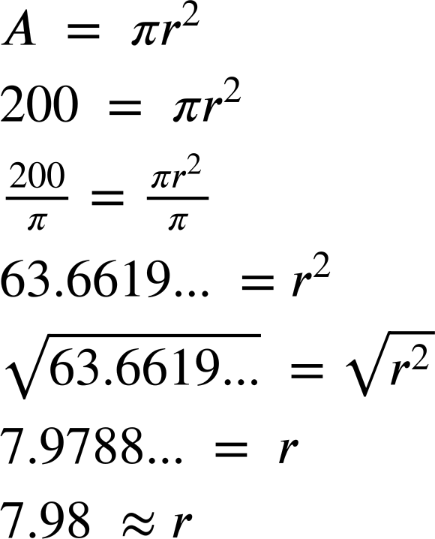
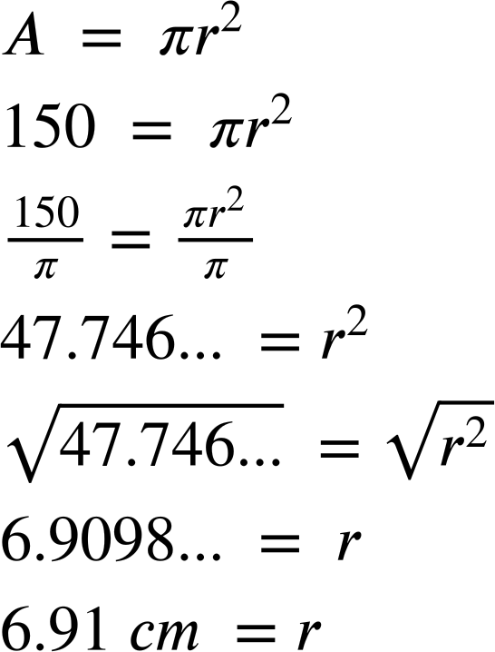
Finding the radius or diameter when the area is known
The area of the circle is 200 cm². Calculate the radius, giving your answer to 2 decimal place.
The area of the circle is 150 cm². Finish calculating the radius, giving your answer to 2 decimal place.
r
r
200 cm²
150 cm²
7.98 cm = r
6.91 cm = r
(to 2 d.p.)
(to 2 d.p.)

Slide 24
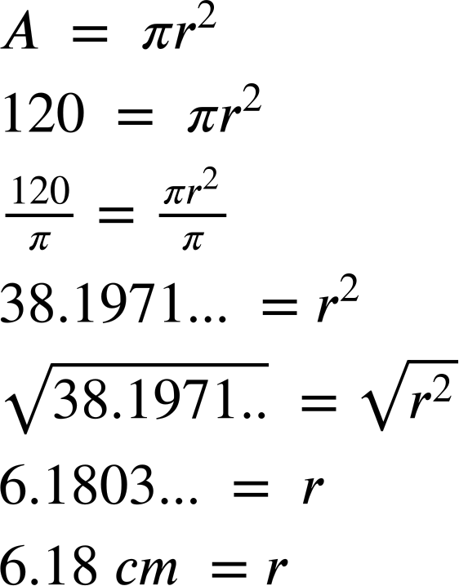
Finding the radius or diameter when the area is known
The area of the circle is 200 cm². Calculate the radius, giving your answer to 2 decimal place.
The area of the circle is 120 cm². Finish calculating the radius, giving your answer to 2 decimal place.
r
r
120 cm²
200 cm²
7.98 cm = r
6.18 cm = r
(to 2 d.p.)
(to 2 d.p.)

Slide 25
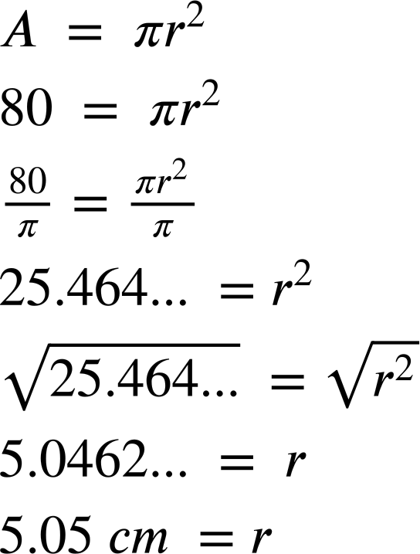
Finding the radius or diameter when the area is known
The area of the circle is 200 cm². Calculate the radius, giving your answer to 2 decimal place.
The area of the circle is 80 cm². Calculate the radius, giving your answer to 2 decimal place.
r
r
80 cm²
200 cm²
7.98 cm = r
5.05 cm = r
(to 2 d.p.)
(to 2 d.p.)

Slide 26
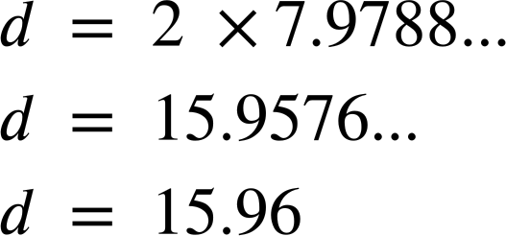
Finding the radius or diameter when the area is known
Once the radius has been obtained, it can be used to calculate the diameter.
Calculate the radius.
Use the radius to calculate the diameter.
d
cm
200 cm²
(to 2 d.p.)
Do not round any numbers before the final solution.

Slide 27
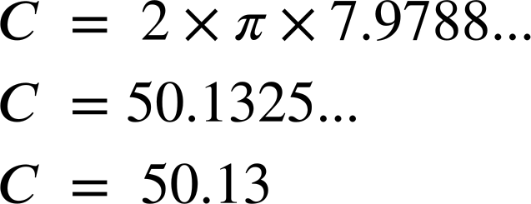
Finding the radius or diameter when the area is known
Once the radius has been obtained, it can be used to calculate the circumference by substituting into the formula C = 2πr.
Calculate the radius.
Use the radius to calculate the circumference.
C
cm
200 cm²
(to 2 d.p.)
Do not round any numbers before the final solution.

Slide 28
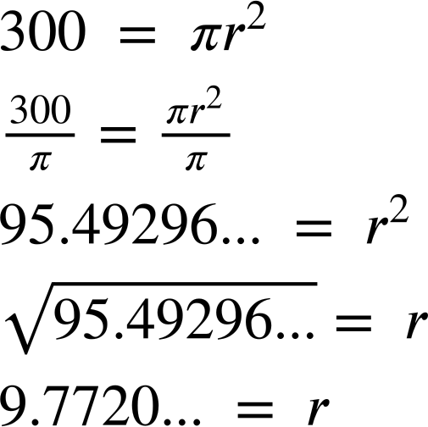


Finding the radius or diameter when the area is known
Sofia is using the area of a circle to calculate its radius. What calculation should she perform next?
95.49296… × 2
95.49296… × π
r
95.49296… × 2 × π
300 cm²

Slide 29
Finding the radius or diameter when the area is known
Sofia is using the area of a circle to calculate its diameter. What calculation should she perform next?
9.7720… × 2
d
9.7720… × π
300 cm²
9.7720… × 2 × π

Slide 30
Finding the radius or diameter when the area is known
Sofia is using the area of a circle to calculate its circumference. What calculation should she perform next?
9.77 × 2
C
9.7720… × π
9.77 × 2 × π
300 cm²
9.7720… × 2 × π

Slide 31
Finding the radius or diameter when the area is known
1) The area of the circle is 500 cm². For each question, give your answer to 1 decimal place. a) Calculate the radius.
b) Calculate the diameter.
c) Calculate circumference.
500 cm²

Slide 32
Finding the radius or diameter when the area is known
1) The area of the circle is 500 cm². For each question, give your answer to 1 decimal place. a) Calculate the radius.
b) Calculate the diameter.
c) Calculate circumference.
12.6 cm
500 cm²
25.2 cm
79.3 cm

Slide 33
Using the formula for the area of a circle
The area of any circle can be found if the radius is known.
The radius can be calculated by halving the diameter.
The area of a circle can be used to calculate the radius or diameter.
Answers written as a decimal will need to be rounded to an appropriate degree of accuracy.
An answer can be exact by writing it in terms of π.

Slide 34

© Oak National Academy 2023.
Produced in partnership with Mathematics in Education and Industry.
Licensed on the Open Government Licence v3.0, except where otherwise stated. See Oak terms and conditions.

